Slide 1
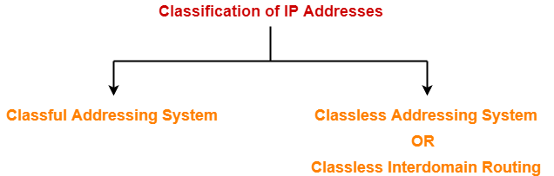

Slide 2
IP address is an address having information about how to reach a specific host, especially outside the LAN. An IP address is a 32 bit unique address having an address space of 2³².

Slide 3

Note
An IPv4 address is 32 bits long.

Slide 4
Note
The IPv4 addresses are unique and universal.

Slide 5
Note
The address space of IPv4 is
₂32
or 4,294,967,296.

Slide 6
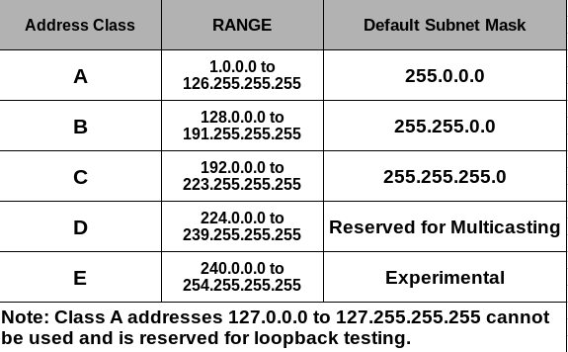

Slide 7
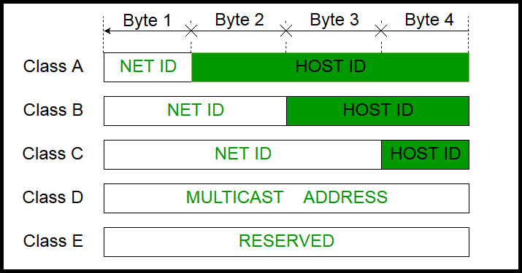
IPv4 address is divided into two parts
Network ID
Host ID

Slide 8
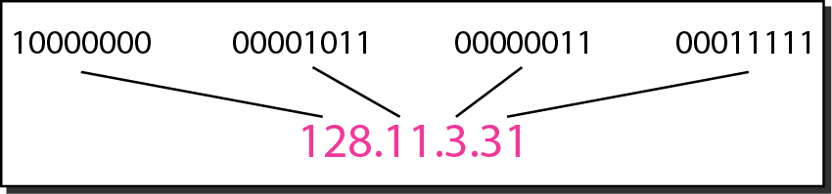
Figure 19.1 Dotted-decimal notation and binary notation for an IPv4 address

Slide 9
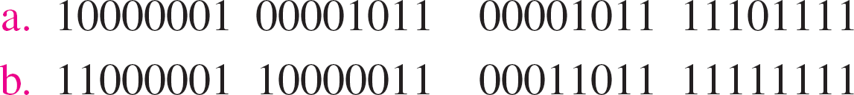
Change the following IPv4 addresses from binary notation to dotted-decimal notation.
Example 19.1
Solution
We replace each group of 8 bits with its equivalent decimal number (see Appendix B) and add dots for separation.
????
????

Slide 10
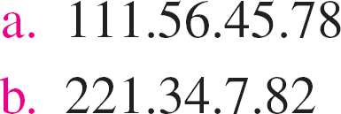
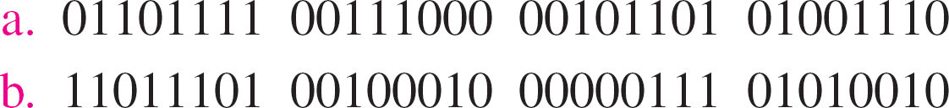
Change the following IPv4 addresses from dotted-decimal notation to binary notation.
Example 19.2
Solution
We replace each decimal number with its binary equivalent (see Appendix B).

Slide 11



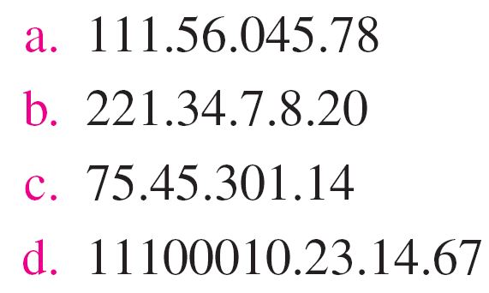
Find the error, if any, in the following IPv4 addresses.
Example 19.3

Slide 12
Note
In classful addressing, the address space is divided into five classes: A, B, C, D, and E.

Slide 13
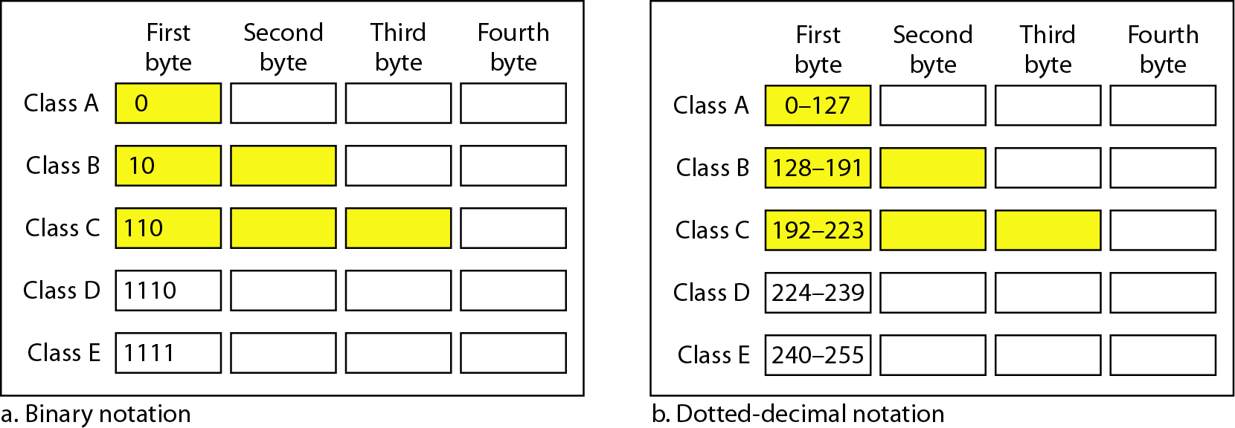
Figure 19.2 Finding the classes in binary and dotted-decimal notation

Slide 14
Find the class of each address.
Example 19.4
a. 00000001 00001011 00001011 11101111
b. 11000001 10000011 00011011 11111111
c. 14.23.120.8
d. 252.5.15.111

Slide 15
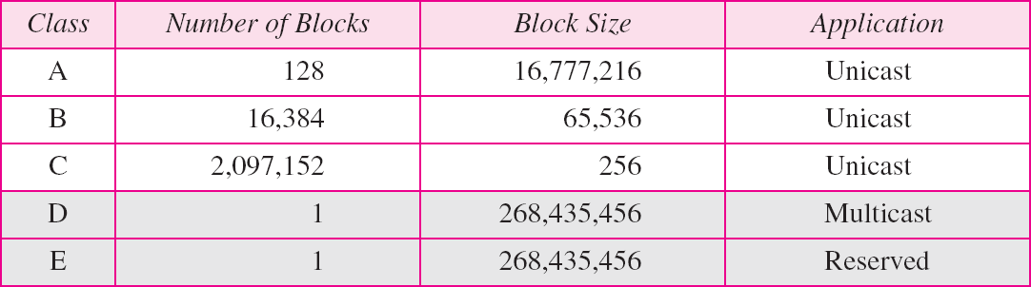
Table 19.1 Number of blocks and block size in classful IPv4 addressing

Slide 16
Note
In classful addressing, a large part of the available addresses were wasted.

Slide 17
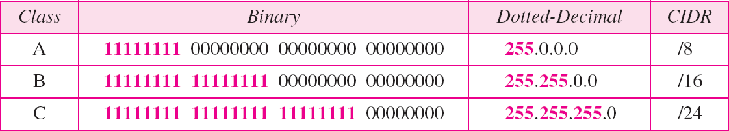
Table 19.2 Default masks for classful addressing

Slide 18
Note
Classful addressing, which is almost obsolete, is replaced with classless addressing.

Slide 19
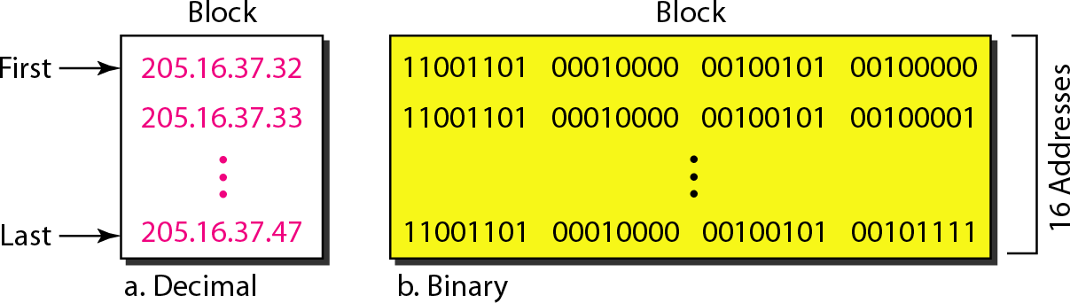
Figure 19.3 A block of 16 addresses granted to a small organization

Slide 20
Note
In IPv4 addressing, a block of addresses can be defined as
x.y.z.t /n
in which x.y.z.t defines one of the addresses and the /n defines the mask.

Slide 21
Note
The first address in the block can be found by setting the rightmost 32 − n bits to 0s.

